Slide 1
Deep Learning [1]
-
Intro to Neural Networks

Slide 2
Firstly, what is a “Neuron”?

Slide 3
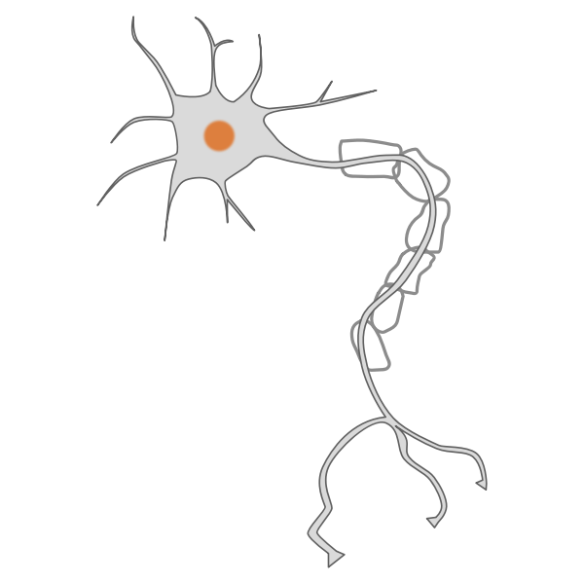
A “Neuron” is a tiny part of the network that makes decisions

Slide 4
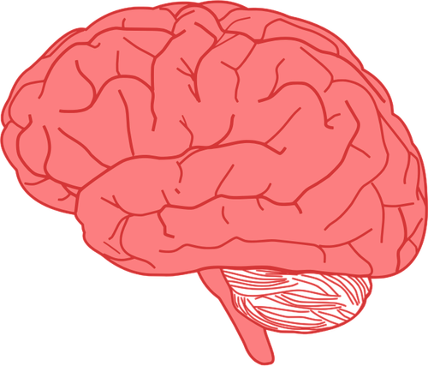
Just like your brain has many neurons that work together, a neural network has lots of these tiny helpers

Slide 5
Neurons are grouped into layers, like teams of helpers

Slide 6
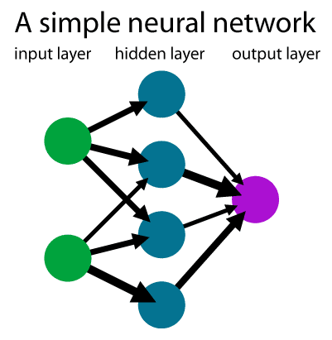
Input Layer - the first team that looks at raw data
Hidden Layer - Middle team that thinks about the data and tries to figure out patterns
Output Layer - The last team that makes the final decision

Slide 7
Let’s look at a simple neural network to read and convert hand-written numbers to text.
This example shows how exactly a neural network works in practice.

Slide 8
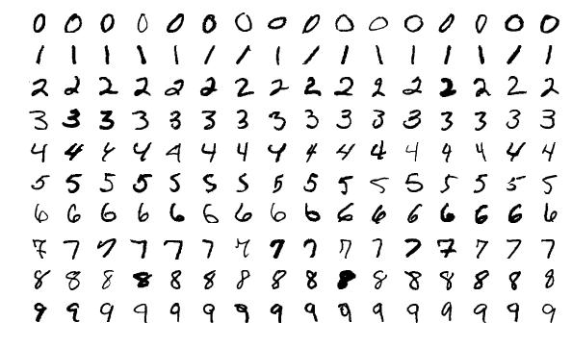
Our input layer (raw dataset)

Slide 9
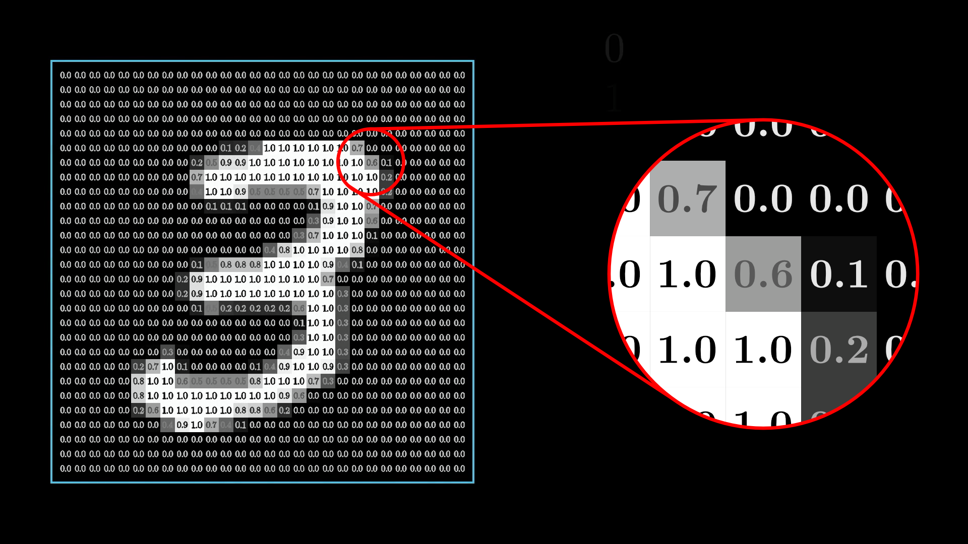
For the model to learn to read a number correctly, it will break down a number into a layer with different weights
A weight is a bias the computer makes which marks a feature as important.

Slide 10
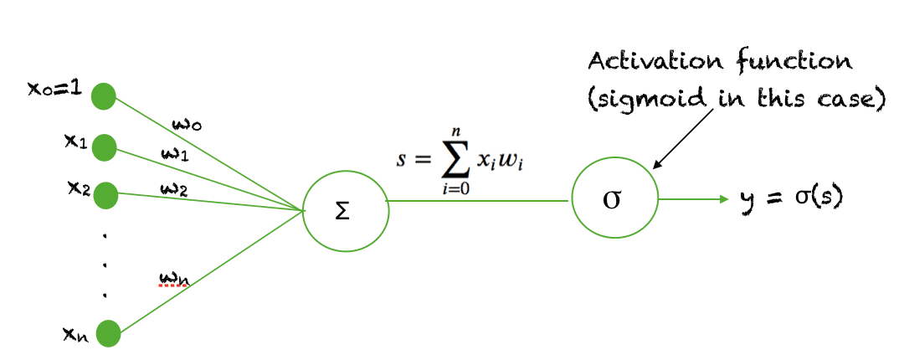
In order to make the weights more accurate and easy-to-calculate, a “filter” of sorts is applied called the activation function.
This is a mathematical function which simplifies the data so that more complex operations can be applied.

Slide 11
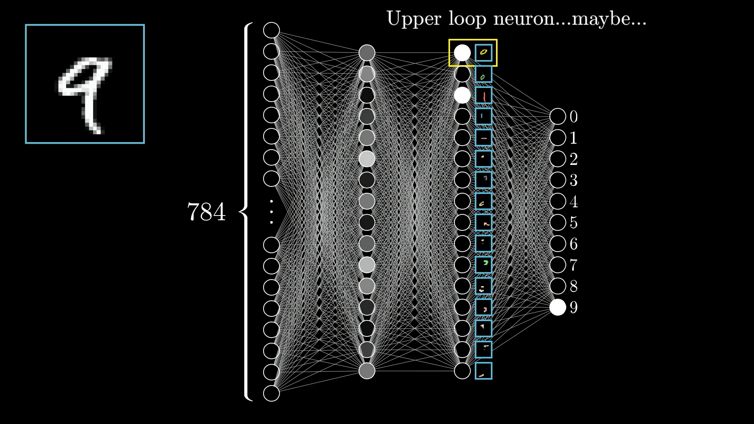
At first, the weights are assigned randomly in a network.
But after some trial-and-error, and many rounds of training, the weights are constantly adjusted to make the predictions more accurate.

Slide 12
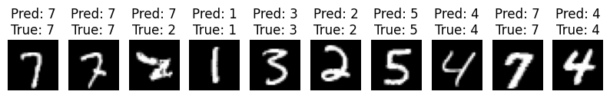
Our output layer (accurate handwriting prediction)

Slide 13
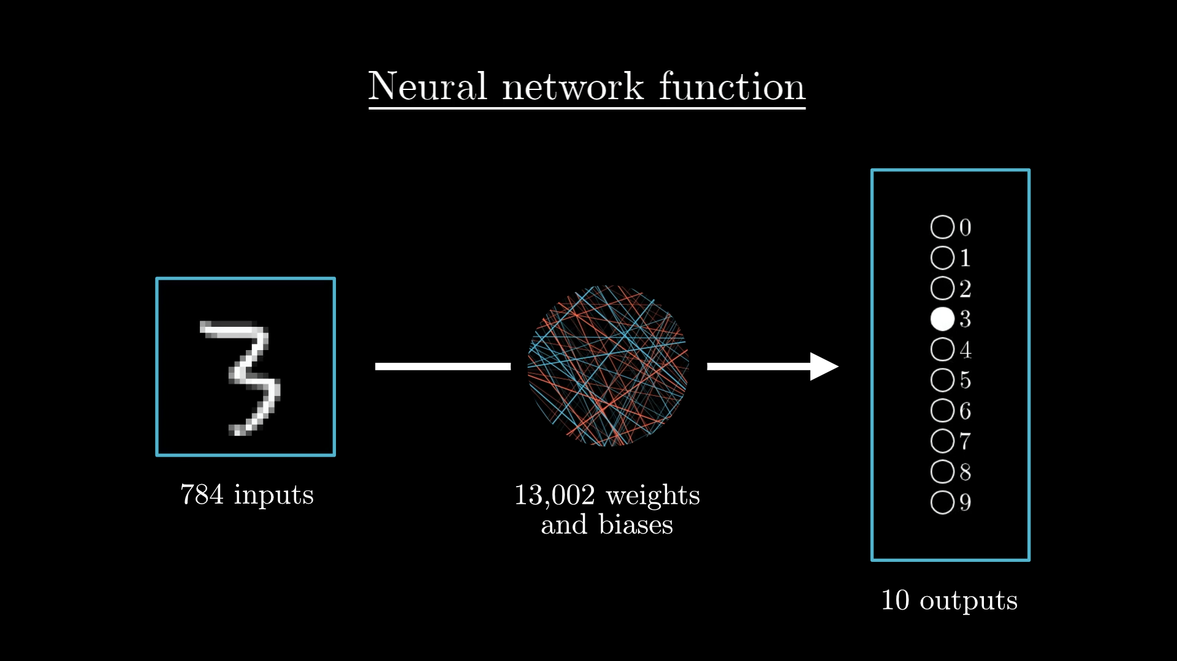
And that’s the basic gist of how a neural network works!

